Slide 1
Manpower planning / human resource planning
Guiding principle for HRP

Slide 2
Introduction
Planning is one of the major tasks of any business organization.
It defined as ‘the process for ensuring that the human resource requirements of an organization are identified and plans are made for satisfying those requirements.
It ensures three main things:
It ensures adequate supply of human resources.
It ensures proper quality of human resources.
It ensures effective utilization of human resources.

Slide 3
The HR manager responsible for planning must ensure that there are right people in the right place for the right job.
This implies:
division of labour,
specialization,
organization of management into levels,
job/work simplification,
application of standards for selecting employees
Measuring employee performance

Slide 4
Objectives of human resource planning
Assessing manpower needs for future and making plans for recruitment and selection.
Assessing skill requirement in future for the organization.
Determining training and the development needs of the organization.
Anticipating surplus or shortage of staff and avoiding unnecessary detentions or dismissals.
Controlling wage and salary costs.

Slide 5
Ensuring optimum use of human resources in the organization.
Helping the organization to cope with the technological development and modernization.
Ensuring career planning of every employee of the organization and making succession programmes.
Ensuring higher labour productivity.

Slide 6
Human resource planning process
HR planning is a process of analyzing and identifying the need or and availability of human resources so that the organization can meet its objectives.
The basis for HR planning is the organizational strategy. Strategic HR planning can be made:
By participating in the organizational planning process
Identify the HR strategies in line with the organizational strategy
Design and develop HR information system

Slide 7
Compile and analyze the available data on staffing needs of various departments.
Identify supply and demand needs for each department in the organization
Review HR planning with the different department
Integrate HR plan with the organizational plan
Monitor the HR plan to keep pace with the changes in the business environment
Develop and review the employee succession plan

Slide 8
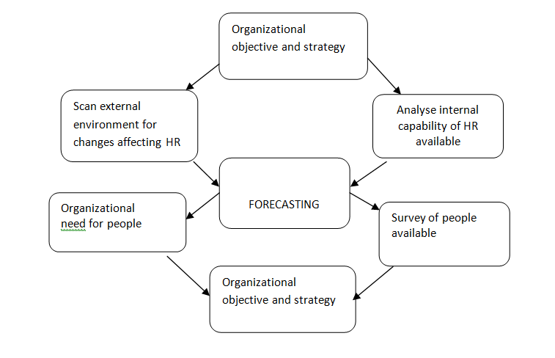
HRH
HR planning process

Slide 9
Significance of HRP
HR planning is considered to be as important as production, finance and marketing planning.
If used properly, it leads to:
the maximum utilization of human resources,
reduces excessive labour turnover and high absenteeism,
improves productivity and aids in achieving the objectives of an organization

Slide 10
The importance of HRP in the organizations can be explained under the following heads:
Obtaining the best employees :
HRP helps in getting the best employees and assigning them the right work so that efficiency and productivity can be maximized.
A good HRP helps in identifying organizational needs, developing people and providing them growth opportunities.
Defining future manpower need :
HRP enables to anticipate the changed requirements of manpower.
It identifies future manpower need which becomes the basis of recruiting and developing personnel.

Slide 11
Coping with changes :
In business environment fast changes are taking place. Every organization is trying to compete on the basis of technology and managerial talents.
In this war, only those companies will survive which adopt a proper human resource planning.
Smooth conduct of work :
To carry on its work, each organization needs personnel with the necessary qualifications and skills.
These are provided through effective manpower planning.

Slide 12
Replacement of personnel :
Meeting the need of expansion programmes :
In order to meet the needs of expansion programmes due to growing population, change in standard of living, change in technology, competitive position of the firm etc., human resource planning is unavoidable
Strike a balance between surplus and shortage of personnel :
Manpower planning is also needed in order to identify areas of surplus personnel or areas in which there is shortage of personnel

Slide 13
Essentials for successful HR planning
There are certain fundamental principles that make human resource planning effective. These are as follows :
Integration with organizational plans :
Human resource planning must be integrated with the organizational plans and objectives to be successful.
There a good communication between the organizational planners and the HR planners for successful human resource planning is a must

Slide 14
Period of manpower planning :
The period of manpower planning should have a connection with the needs and circumstances of the enterprise.
The size and structure of an enterprise as well as the anticipated changes must be taken into consideration while going for manpower planning.
Proper organization :
It is necessary to organize the planning function properly in order to make it successful.
It is advisable to have a separate cell or constitute a committee within the human resource department in order to provide adequate focus and to coordinate the planning work at various levels.

Slide 15
Support of top management :
The top management should give full support and co-operation to make the manpower planning effective.
The support of top management facilitates the process of getting necessary resources, cooperation and other things as per requirement to make the planning successful.
Involvement of operating executives :
Human resource planning is not a function of manpower planners only but also of the operating executives too.
Participation of other executives make the process of manpower planning understandable to everyone so that chances of resistance can be rooted out in time.

Slide 16
Efficient and reliable information system :
An adequate data base must be developed for the human resource of an organization to facilitate the process of human resource planning.
Balanced Approach :
Both the qualitative and quantitative aspects of manpower should be given equal weight by the human resource experts.
Emphasis should be more on filling the future vacancies with right people rather than matching the existing jobs.
The matters of promotions, career planning and development, skill levels, morale etc. should also be given due importance by the planners.

Slide 17
Factor affecting HRP
External factors
Internal factors

Slide 18
External Factors
Government Policies: Policies of the government like labour policy, industrial relations policy, policy towards reserving certain jobs for different communities
Level of Economic Development: Level of economic development determines the level of HRD in the country and thereby the supply of human resources in future in the country

Slide 19
Business Environment: External business environmental factors influences the volume and mix of production and thereby the future demand for human resources.
Level of Technology: Level of technology determines the kind of human resources required.
International Factors: International factors like the demand for the resources and supply of human resources in various countries.

Slide 20
Internal factors
Company Policies and Strategies: Company’s policies and strategies relating to expansion diversification, alliances, etc. determines the human resource demand in terms of quality and quantity.
Human Resource Policies: Human resources policies of the company regarding quality of human resource, compensation level, quality of work life, etc. influences human resource plan.

Slide 21
Job Analysis: Fundamentally, human resource plan is based on job analysis. Job description and job specification determines the kind of employees required.
Time Horizons: Companies with stable competitive environment can plan for the long run whereas the firms with unstable competitive environment can plan for only short-term range

Slide 22
Techniques of forecasting human resources
Human resource forecasting is the determination of the demand for different categories of employees with appropriate skills for specified time periods in the future.
The forecast also requires the preparation of an estimate of the availability of employees during the selected time periods.
Generally, human resource planners make use of a variety of techniques to project future personnel needs.
Major forecasting techniques are demand and supply

Slide 23
Demand forecast
Demand forecasting is the process of estimating the future requirements of manpower, by function and by level of skills.
It concerned with forecasting of the quality of human resources in addition to quantity of human resources.
Two kinds of forecasting techniques are commonly used to determine the organization’s projected demand for human resources. These are:
(i) Judgmental forecasts, and
(ii) Statistical projections.

Slide 24
Judgmental Forecasts
Judgmental forecasts are also known as the conventional method
The forecasts are based on the judgment of those managers and executives who have intensive and extensive knowledge of human resource requirement.
Judgmental forecasts could be of two types:
Managerial Estimate
Delphi Method

Slide 25
Managerial Estimate
Under this method, the managers or supervisors who are well-acquainted with the workload, efficiency and ability of employees, think about their future workload, future capabilities of employees and decide on the number and type of human resources to be required.
An estimate of staffing needs is done by the lower level managers who make estimates and pass them up for further revision

Slide 26
Delphi Technique
The Delphi technique It is a structured approach for reaching a consensus judgment among the experts regarding the number of employees.
Delphi process requires a large number of experts who take turns to present their forecast statement and underlying assumptions to the others, who then make revisions in their forecasts
The experts may be both from within or outside the organization. However, face-to-face contact among the experts is avoided
The Delphi techniques has been found to be good for short duration (1 year) forecast.

Slide 27
Statistical Projection
Some forecasting techniques are based on statistical methods. Such as
Ratio-Trend Analysis
Econometric Model
Work-Study Techniques

Slide 28
Ratio-Trend Analysis
The ratio-trend analysis is carried out by studying the past ratios and the forecasting ratios for the future.
The components of internal environmental changes are considered while forecasting the future ratios.
Activity level forecasts are used to determine the direct human resource requirements.
This method depends on the availability of past records and the internal environmental changes likely to occur in future

Slide 29
Econometric Model
Under the econometric model, the previous data is analyzed and the relationship between different variables in a mathematical formula is developed.
The different variables affecting the human resource requirements are identified.
The mathematical formula so developed is then applied to the forecasts of movements in the identified variables to produce human resource requirements

Slide 30
Work-study techniques
Work-study techniques are generally used to study work measurement.
Under the workload analysis, the volume of workload in the coming years is analyzed.
These techniques are more suitable where the volume of work is easily measurable.

Slide 31
Supply Forecasting
Supply forecasting measures the number of people likely to be available from within and outside the organization after making allowance for absenteeism, internal movement, promotion, changes in hours and other conditions of work.
Supply analysis covers :
a) Existing human resource supply.
b) Internal source of supply.
c) External source of supply

Slide 32
Forecasting of human resources begins with the current human resource inventory, also called human resource audit.
Human resource inventory contains information about present human resources in the organizatn
It reveals what is available in the stock of manpower and what can be expected in future.
It can indicate whether the supply of human resources is less than its demand or more than its demand

